Slide 1
!XOBILE LANGUAGE SER 502 – FINAL PROJECT TEAM 12
TEAM MEMBERS -
Janani Anand – 1215175481
Nikhila Saini – 1216596212
Manikanta Chintakunta -1215146842
Vaibhav Singhal - 1215185400

Slide 2
OVERVIEW
Grammar used for the language
Lexical Analyzer
Parser / Syntax Tree
Semantics
Sample Programs

Slide 3
LANGUAGE DESIGN FLOW
SOURCE CODE
Input
LEXER
Tokens
PARSER
Parse Tree
OUTPUT
SEMANTICS
Environment

Slide 4
KEY FEATURES OF THE LANGUAGE
Data types - integer, boolean
Arithmetic operators- addition, subtraction, multiplication, division
Decision control statements- if - else,
Looping construct – while
Comparison operators- equalto, notequalto , greater than, less than (works for multiple expressions as well)
Developed in Prolog and Python
Python – used for tokenisation
Prolog –used for syntax tree generation, semantics and final program evaluation

Slide 5
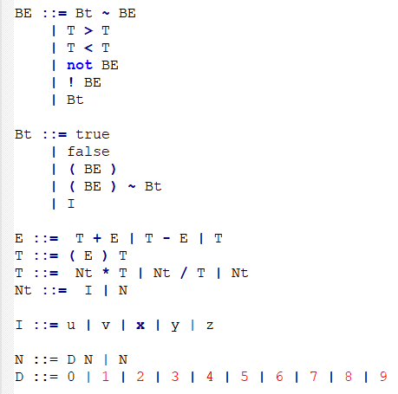
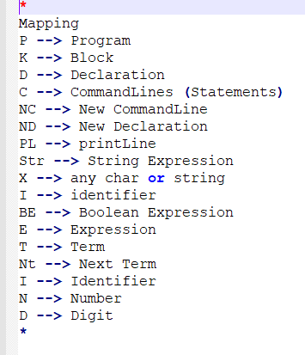
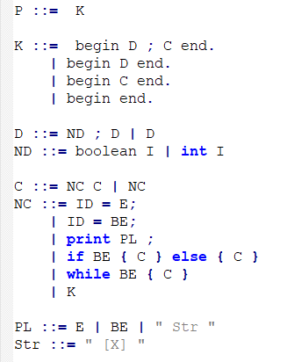
GRAMMAR

Slide 6
LEXICAL ANALYZER AND PARSER
Takes the input program file – first.lol and generates a list of tokens eliminating spaces, tabs and new lines
Tokens are stored in a file and given to a parser
The parser converts this into a syntactic form according to the defined grammar rules and then generates the syntax tree
Parsed in a top down fashion

Slide 7
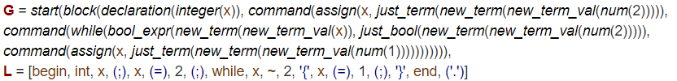
SYNTAX TREE

Slide 8
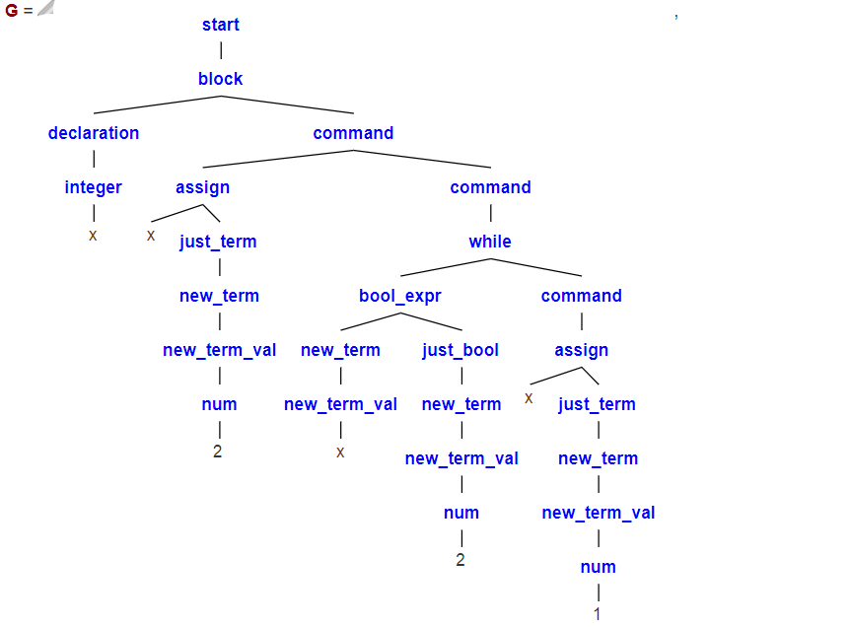

Slide 9
SEMANTICS
Semantics is defined for the generated syntax tree using Prolog
The 4 main predicates defined are – lookup, update, addEnv and eval.
There are multiple eval predicates which are mapped with each predicate of the parsetree individually.
The final environment generated from the semantics hold the variable value pairs

Slide 10
RUNTIME EXECUTION

Slide 11
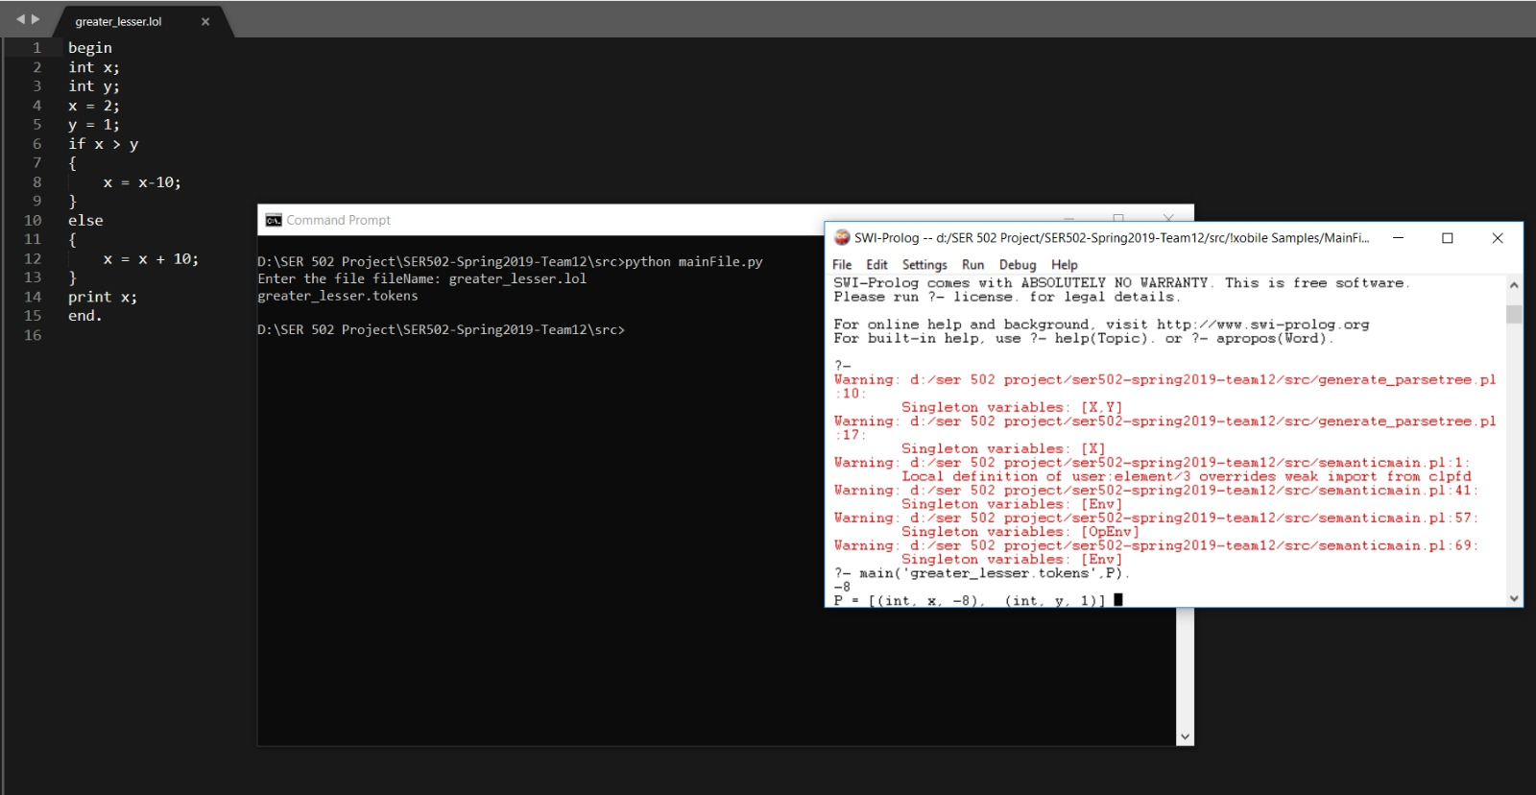
OUTPUT SCREENSHOTS

Slide 12
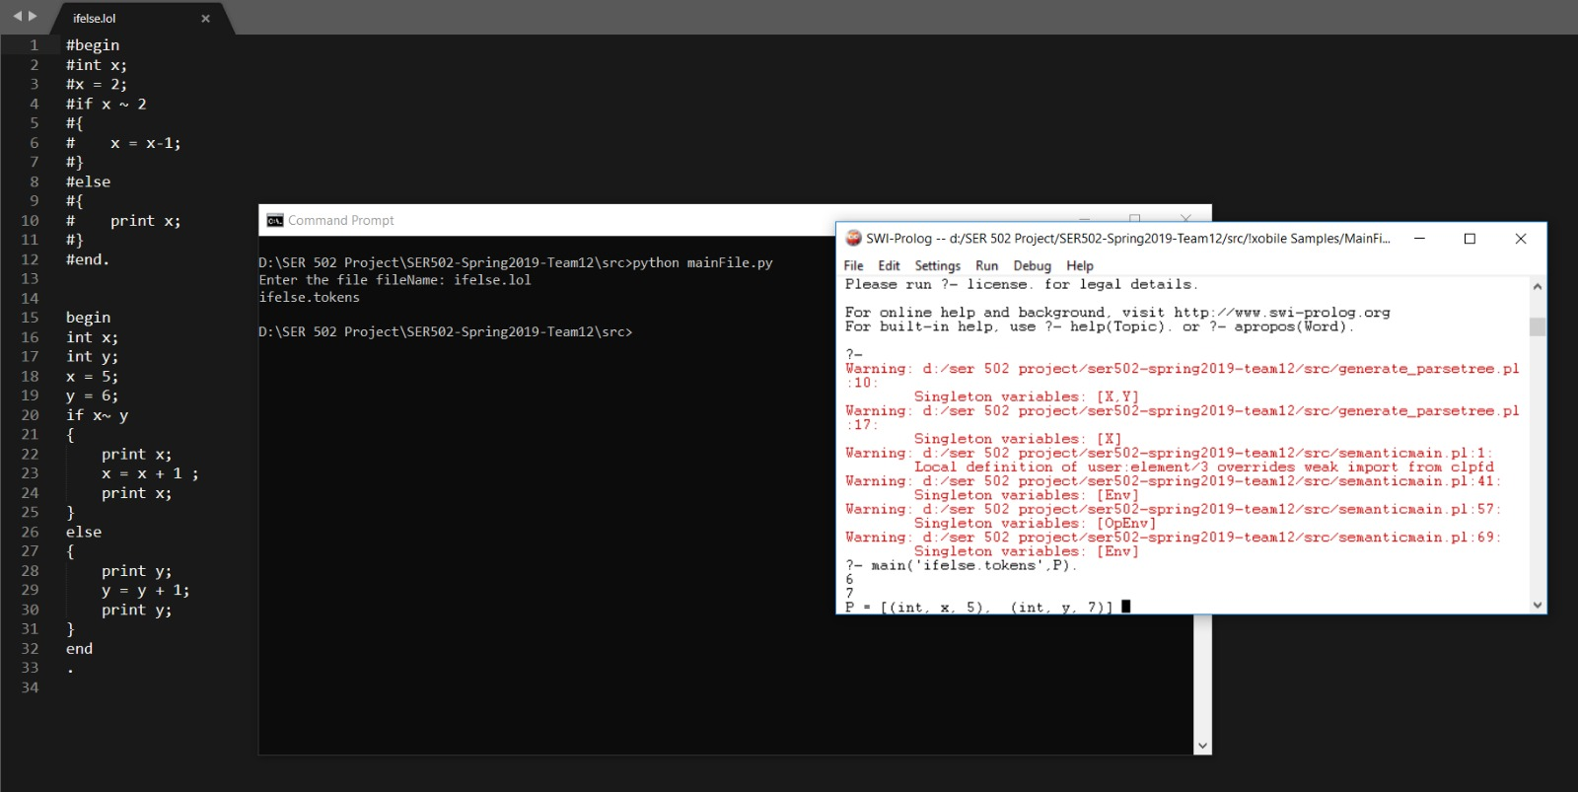

Slide 13


Slide 14
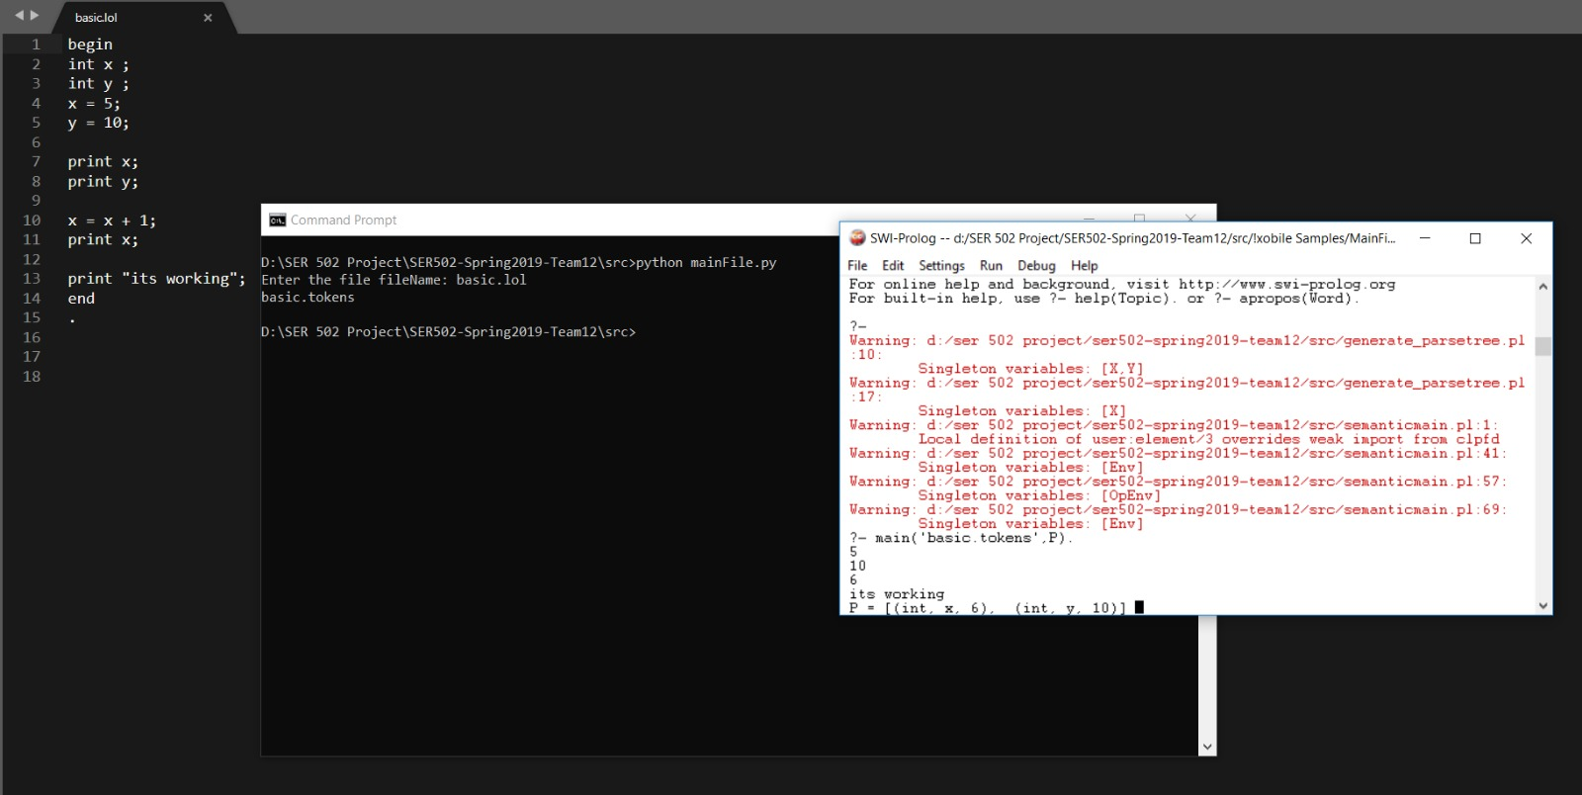

Slide 15
THANKYOU

